Slide 1
DESIGN AND ANALYSIS OF ALGORITHMS
Dr Y V K Ravi Kumar, BITS- Pilani

Slide 2
Dynamic Programming – Longest Common Subsequence

Slide 3
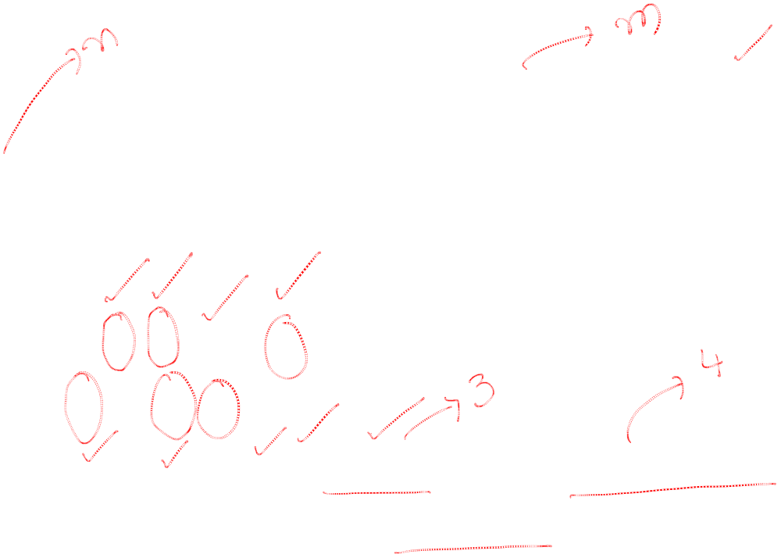
Longest Common Subsequence(LCS)
Problem: Given two sequences, X = ⟨x₁,...,x_{m}⟩ and Y = ⟨y₁,...,y_{n}⟩, find a common subsequence whose length is maximum.
Consider X = < A B C B D A B > and
Y = < B D C A B A >
Then the sequences < B C A> and < B C B A> are common subsequences. But < B C B A > is an LCS of X and Y
Subsequence need not be consecutive, but must be in order.

Slide 4
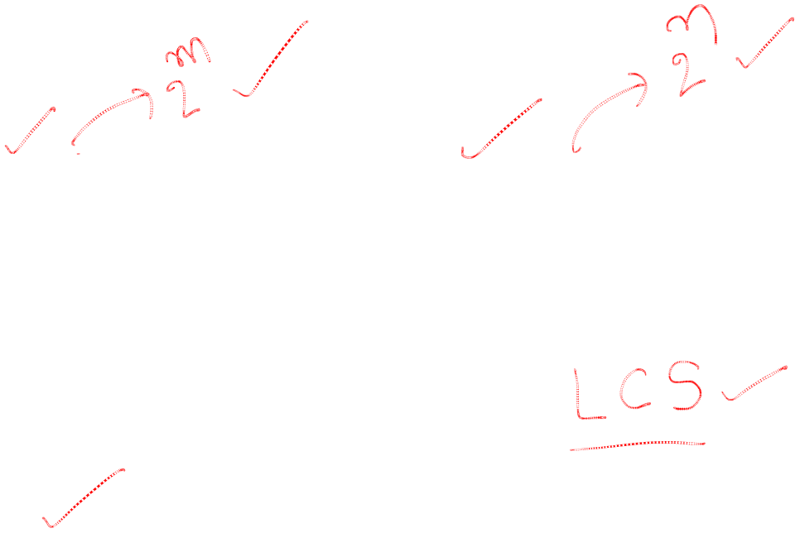
How to find LCS
Brute Force:
X = < x1,x2,x3….xm > and Y = < y1,y2,y3…yn >
For every subsequence of X, check whether it’s a subsequence of Y .
Time: Θ(n2^{m}).
  2^{m} subsequences of X to check.
  Each subsequence takes Θ(n) time to check:
  scan Y for first letter, for second, and so on.

Slide 5
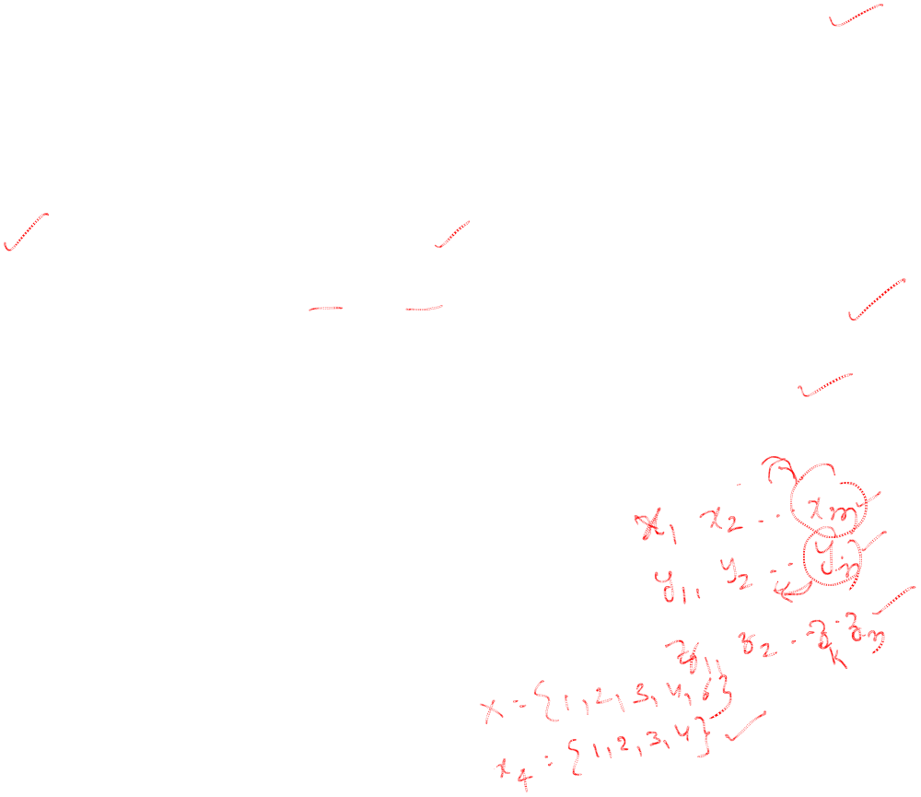
Step 1: Characterizing a longest common subsequence
Optimal Substructure
Theorem
Let Z = ⟨z₁, . . . , z_{k}⟩ be any LCS of X and Y .
1. If x_{m} = y_{n}, then z_{k} = x_{m} = y_{n} and Z_{k-1} is an LCS of X_{m-1} and Y_{n-1}.
2. If x_{m} ≠ y_{n}, then either z_{k} ≠ x_{m} and Z is an LCS of X_{m-1} and Y .
3. or z_{k} ≠ y_{n} and Z is an LCS of X and Y_{n-1}.
Notation:
prefix X_{i} = ⟨x₁,...,x_{i}⟩ is the first i letters of X.

Slide 6
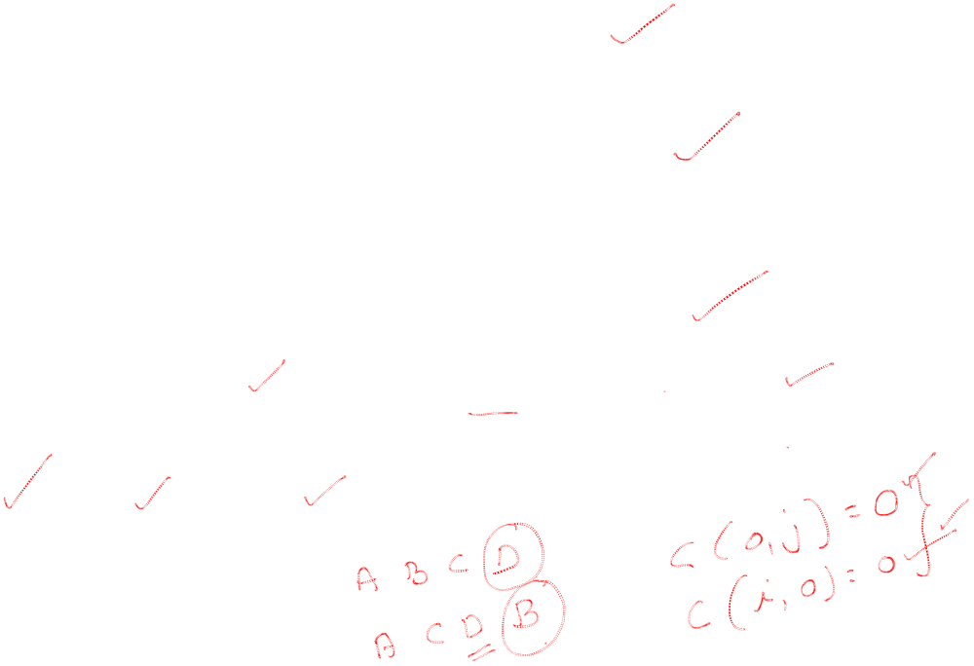
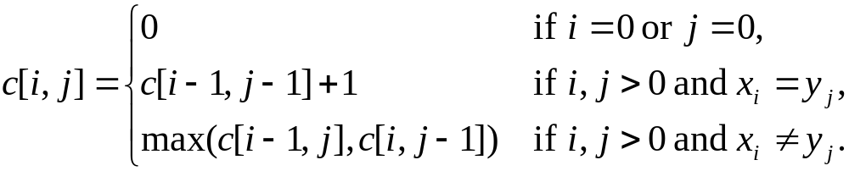
Step 2:Recursive Solution
Define c[i, j] = length of LCS of X_{i} and Y_{j} .
We want c[m,n].

Slide 7
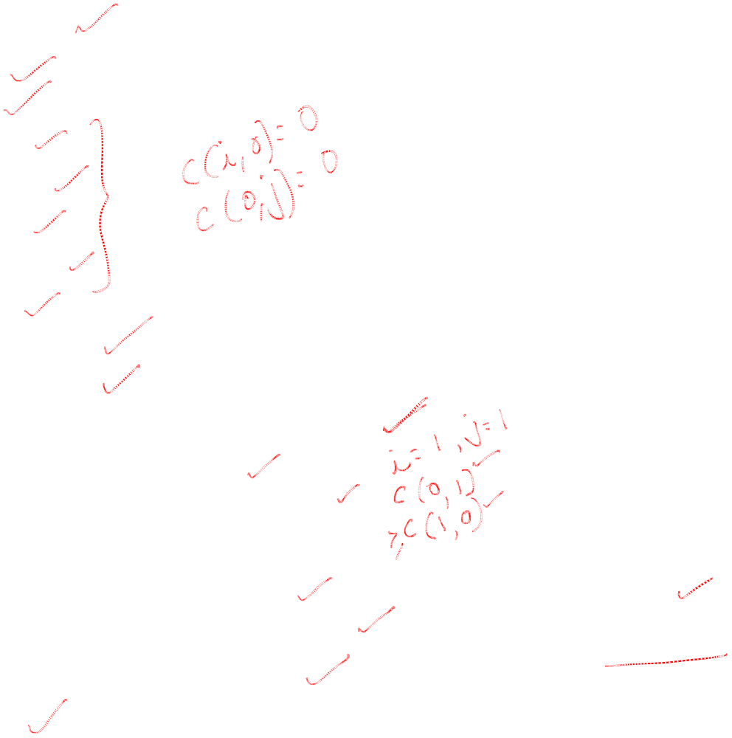
Step 3: Computing the length of an LCS
LCS-LENGTH (X, Y)
m ← length[X]
n ← length[Y]
for i ← 1 to m
do c[i, 0] ← 0
for j ← 0 to n
do c[0, j ] ← 0
for i ← 1 to m
do for j ← 1 to n
do if x_{i} = y_{j}
then c[i, j ] ← c[i−1, j−1] + 1
b[i, j ] ← “ ”
else if c[i−1, j ] ≥ c[i, j−1]
then c[i, j ] ← c[i− 1, j ]
b[i, j ] ← “↑”
else c[i, j ] ← c[i, j−1]
b[i, j ] ← “←”
return c and b
b[i, j ] points to table entry whose subproblem we used in solving LCS of X_{i} and Y_{j}.
c[m,n] contains the length of an LCS of X and Y.
Time: O(mn)

Slide 8

Step 4:Constructing an LCS
PRINT-LCS (b, X, i, j)
if i = 0 or j = 0
then return
if b[i, j ] = “ ”
then PRINT-LCS(b, X, i−1, j−1)
print x_{i}
elseif b[i, j ] = “↑”
then PRINT-LCS(b, X, i−1, j)
else PRINT-LCS(b, X, i, j−1)

Slide 9
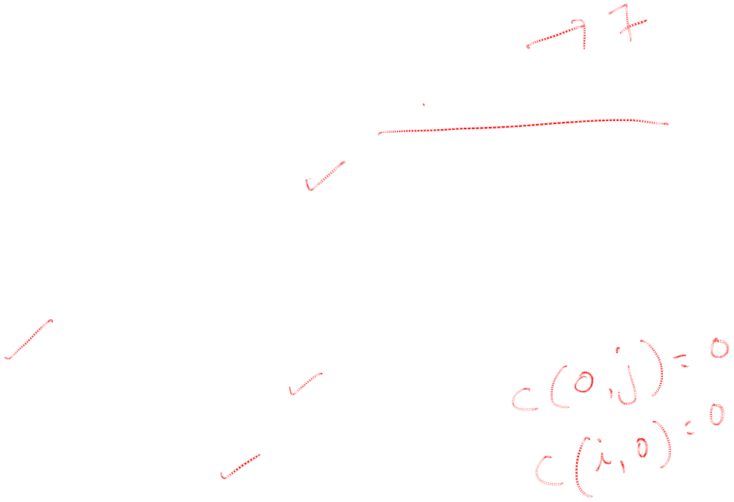
Example
Find LCS of the strings X = < A B C B D A B>
and Y = < B D C A B A >
Here m = 7 and n = 6
Now for i=1 to 7, c(i , j) = 0
And j = 1 to 6, c(i , j) = 0

Slide 10
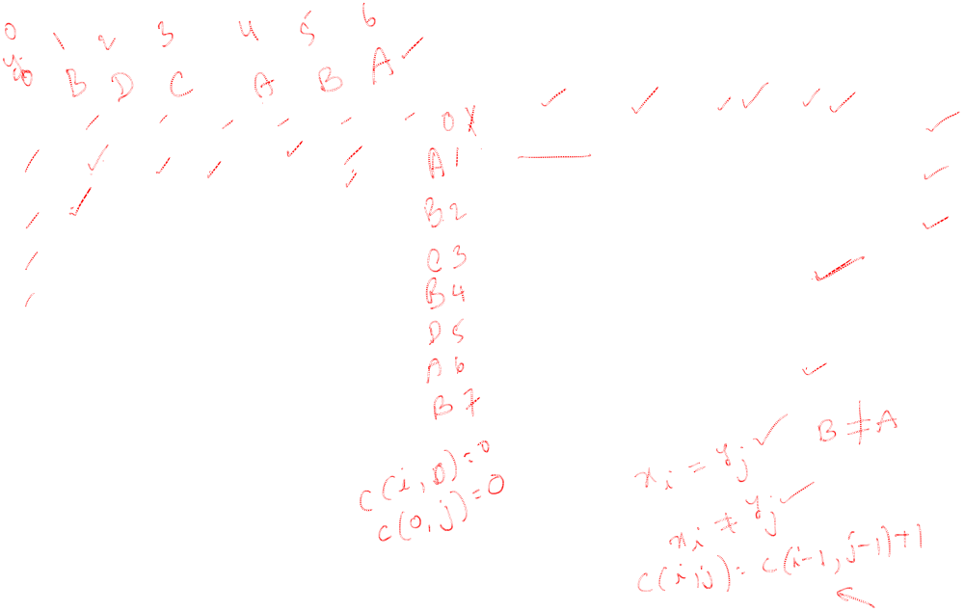
1
0 | 0 | 0 | 0 | 0 | 0 | 0
0 | 0 | 0 | 0 | 1 | 1 | 1
0
0
0
0
0
0
C(1,1)=max{c(0,1),c(1,0)} = 0
C(1,2)=max{c(0,2),c(1,1)} = 0
C(1,3)=max{c(0,3),c(1,2)} = 0
C(1,4)=c(0,3) + 1= 1
C(1,5)=max{c(0,5),c(1,4)} = 1
C(1,6)=c(0,5) + 1 = 1

Slide 11
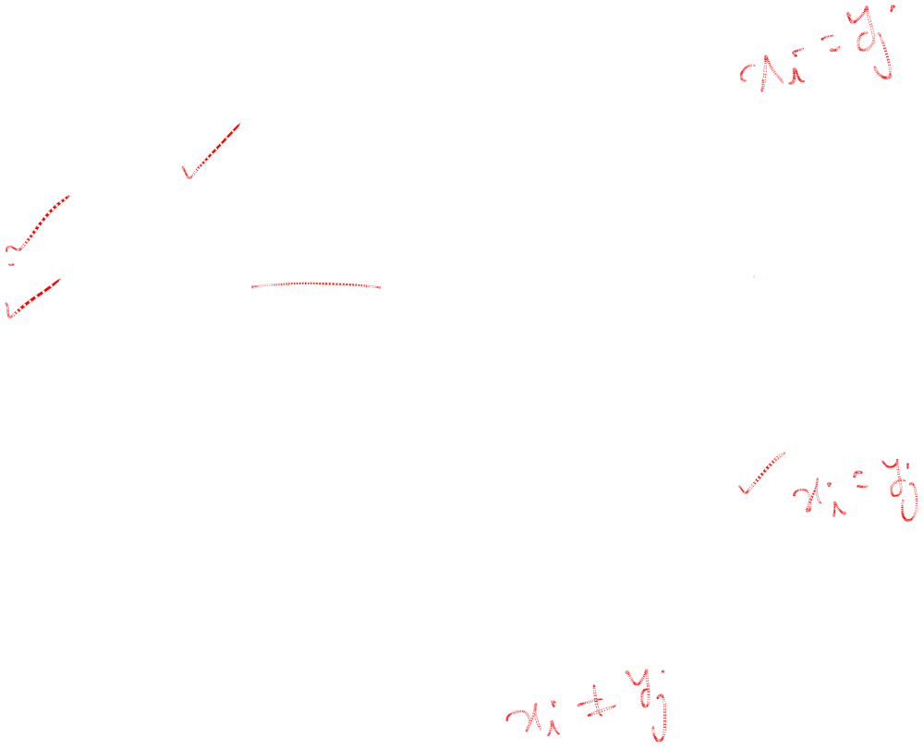
2
0 | 0 | 0 | 0 | 0 | 0 | 0
0 | 0 | 0 | 0 | 1 | 1 | 1
0 | 1 | 1 | 1 | 1 | 2 | 2
0
0
0
0
0
C(2,1)= c(1,0) + 1 = 1
C(2,2)=max{c(1,2),c(2,1)} = 1
C(2,3)=max{c(1,3),c(2,2)} = 1
C(2,4)=max{c(1,4),c(2,3)} = 1
C(2,5)=c(1,4) + 1 = 2
C(2,6)=max{c(1,6),c(2,5)} = 2

Slide 12

3
0 | 0 | 0 | 0 | 0 | 0 | 0
0 | 0 | 0 | 0 | 1 | 1 | 1
0 | 1 | 1 | 1 | 1 | 2 | 2
0 | 1 | 1 | 2 | 2 | 2 | 2
0
0
0
0
C(3,1)=max{c(2,1),c(3,0)} = 1
C(3,2)=max{c(2,2),c(3,1)} = 1
C(3,3)=c(2,2) + 1= 2
C(3,4)= max{c(2,4),c(3,3)} = 2
C(3,5)=max{c(2,5),c(3,4)} = 2
C(3,6)=max{c(2,6),c(3,5)} = 2

Slide 13

4
0 | 0 | 0 | 0 | 0 | 0 | 0
0 | 0 | 0 | 0 | 1 | 1 | 1
0 | 1 | 1 | 1 | 1 | 2 | 2
0 | 1 | 1 | 2 | 2 | 2 | 2
0 | 1 | 1 | 2 | 2 | 3 | 3
0
0
0
C(4,1)=c(3,0) + 1 = 1
C(4,2)=max{c(3,2),c(4,1)} = 1
C(4,3)=max{c(3,3),c(4,2)} = 2
C(4,4)= max{c(3,4),c(4,3)} = 2
C(4,5)=c(3,4) + 1 = 3
C(4,6)=max{c(3,6),c(4,5)} = 3

Slide 14

5
0 | 0 | 0 | 0 | 0 | 0 | 0
0 | 0 | 0 | 0 | 1 | 1 | 1
0 | 1 | 1 | 1 | 1 | 2 | 2
0 | 1 | 1 | 2 | 2 | 2 | 2
0 | 1 | 1 | 2 | 2 | 3 | 3
0 | 1 | 2 | 2 | 2 | 3 | 3
0
0
C(5,1)= max{c(4,1),c(5,0)} = 1
C(5,2)=c(4,1)} +1 = 2
C(5,3)=max{c(4,3),c(5,2)} = 2
C(5,4)= max{c(4,4),c(5,3)} = 2
C(5,5)=max{c(4,4),c(5,3)} = 3
C(5,6)=max{c(4,6),c(5,5)} = 3

Slide 15

6
0 | 0 | 0 | 0 | 0 | 0 | 0
0 | 0 | 0 | 0 | 1 | 1 | 1
0 | 1 | 1 | 1 | 1 | 2 | 2
0 | 1 | 1 | 2 | 2 | 2 | 2
0 | 1 | 1 | 2 | 2 | 3 | 3
0 | 1 | 2 | 2 | 2 | 3 | 3
0 | 1 | 2 | 2 | 3 | 3 | 4
0
C(6,1)= max{c(5,1),c(6,0)} = 1
C(6,2)= max{c(5,2),c(6,1)} = 2
C(6,3)=max{c(5,3),c(6,2)} = 2
C(6,4)= c(5,3) + 1 = 3
C(6,5)=max{c(5,5),c(6,4)} = 3
C(6,6)=c(5,5) + 1 = 4

Slide 16
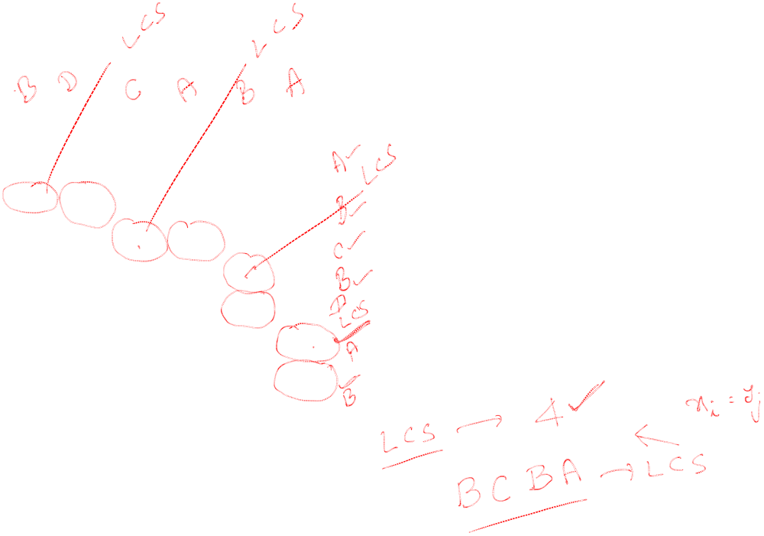
7
0 | 0 | 0 | 0 | 0 | 0 | 0
0 | 0 | 0 | 0 | 1 | 1 | 1
0 | 1 | 1 | 1 | 1 | 2 | 2
0 | 1 | 1 | 2 | 2 | 2 | 2
0 | 1 | 1 | 2 | 2 | 3 | 3
0 | 1 | 2 | 2 | 2 | 3 | 3
0 | 1 | 2 | 2 | 3 | 3 | 4
0 | 1 | 2 | 2 | 3 | 4 | 4
C(7,1)= c(6,0) + 1 = 1
C(7,2)= max{c(6,2),c(7,1)} = 2
C(7,3)=max{c(6,3),c(7,2)} = 2
C(7,4)= max{c(6,4),c(7,3)} = 3
C(7,5)= c(6,4) + 1 = 4
C(7,6)= max{c(6,6),c(7,5)} = 4

Slide 17
Thank You

